Slide 1
US Presidential Projections: 2024
ASU –VIRT-AI-PT-03-2024-U-LOLC-MTTH
Project 1
Presenters:
Krishan Fotedar
Cristina Frisby

Slide 2
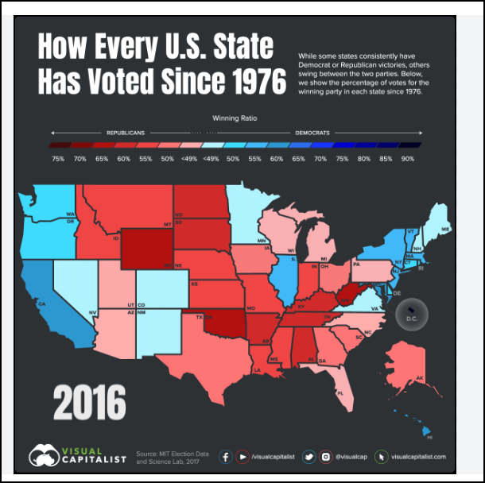
About THIS PROJECT
This project is an academic collaboration to meet the certification requirements of Project, Artificial Intelligence Bootcamp.
Presenting Students: Cristina Frisby & Krishan Fotedar

Slide 3
Why Election Data Analytics?
Impact
Financial
Personal
Global

Slide 4
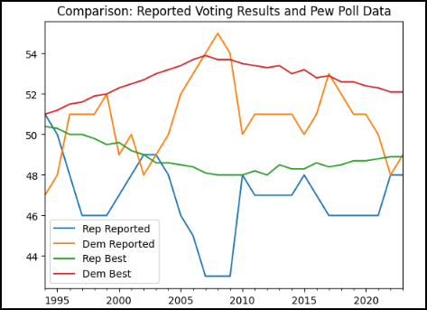
Results Actual Election Results vs Polls (Pew): 1994 through 2023
General Comparison:
Primary Party Candidate Voting Results vs. Predicted Model From Poll Results using “prophet”
Variances and Similarities:
2008 Anomaly

Slide 5
Results Pew Poll Models 1994 through 2024: Men and Women Voters
General Comparison:
Polling Data Model from 1994 through 2023 and “prophet” prediction for 2024
Variances and Similarities:
Three of 4 groups show little change after 2008 (less than 1%): Stable
One Group indicates a negative trend of more than 2%: Democrat Women

Slide 6
Results Pew Poll Models 1994 through 2024: Voters by Racial and Ethnic Groups
2024 Impact:
Slightly Upward: White and Hispanic Republican Voters
Slightly Downward: Black Republican Voters
Significantly Downward: Asian Republican Voters
Should The Republica Party focus on Asian Voters to disrupt the trend?
Who are Asian Voters and what are their issues? How diverse is this demographic?

Slide 7
Results Pew Poll Models 1994 through 2024: Voters by Racial and Ethnic Groups
2024 Impact:
Significantly Upward: Asian Democrat Voters
Slightly Downward: White Democrat Voters
Significantly Downward: Hispanic and Black Democrat Voters
Should the Democratic Party focus on Black and Hispanic voters to disrupt the trend?

Slide 8
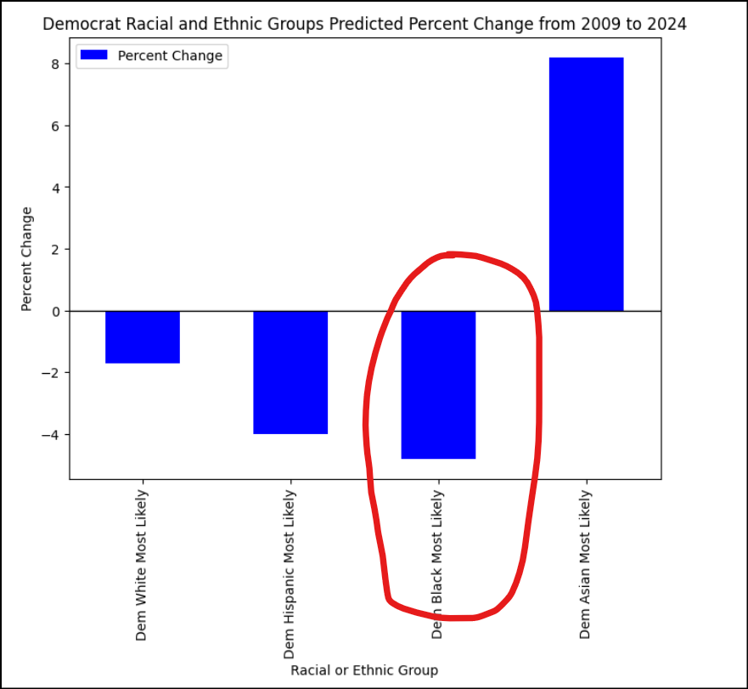
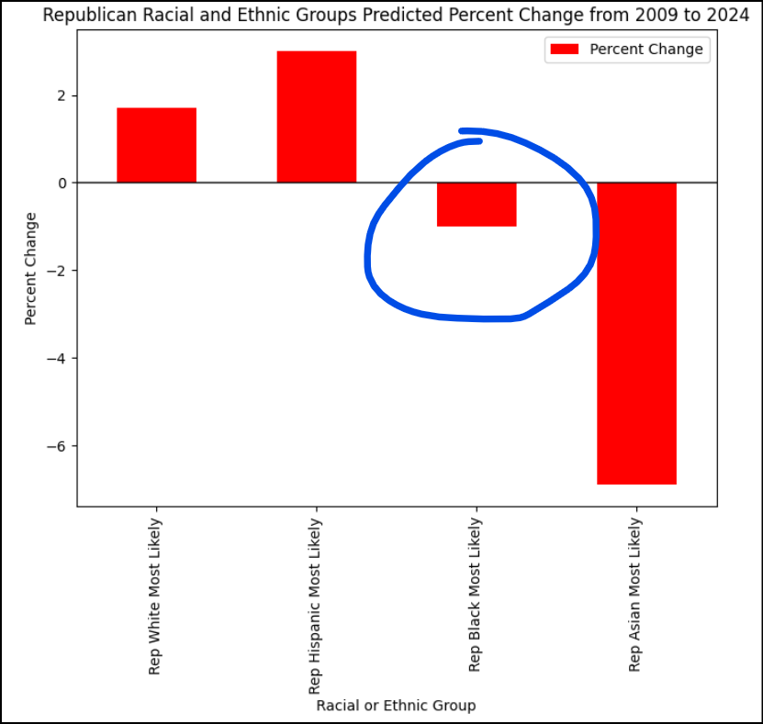
Results Pew Poll Models 1994 through 2024: Voters by Racial and Ethnic Groups
Voting “Swap”:
White, Hispanic and Asian demographics are “swapping” similar percentage points on Republican and Democrat Parties.
Where are the Black voters going? Black voters trending negative both Democrat and Republican.
Are Democrats more impacted by the trend than Republicans?

Slide 9
Results Pew Poll Models 1994 through 2024: Racial & Ethnic Demographics
General Comparison:
Polling Data Model from 1994 through 2023 and “prophet” prediction for 2024
Variances and Similarities:
Three of 4 groups show little change after 2008 (less than 1%)
One Group indicates a negative trend of more than 2%: Democrat Women
Questions:
Could this negative impact Democrats in 2024?
Should The Democratic Party focus on its Women Demographic?

Slide 10




Solution
Close the gap
Target audience
Cost savings
Easy to use
Our product makes consumer lives easier, and no other product on the market offers the same features​
Gen Z (18-25 years old)
Reduce expenses for replacement products
Simple design that gives customers the targeted information they need​

Slide 11



Product Overview
Unique
First to market
Only product specifically dedicated to this niche market
First beautifully designed product that's both stylish and functional​
Tested
Authentic
Conducted testing with college students in the area​
Designed with the help and input of experts in the field ​

Slide 12
Product Benefits
Cool and stylish product​
Areas for community connections
Online store and market swap​

Slide 13
Company Overview

Slide 14



Business Model
Research​
Abstract​
Design​
We based our research on market trends and social media​
We believe people need more products specifically dedicated to this niche market​
Minimalist and easy to use ​

Slide 15
Market opportunity overview
$3b
$1b
$2b
Opportunity to build​
Fully inclusive market​
Total addressable market​
Freedom to invent​
Selectively inclusive market​
Serviceable available market​
Few competitors​
Specifically targeted market​
Serviceable obtainable market​

Slide 16
Market opportunity comparison
$3B
Opportunity to Build
Revenue over 12 months​
$2B
Freedom to Invent
Market share​
$1B
Few Competitors
Obtainable market​

Slide 17
Our competition
CoNTOSO
competitors
Our product is priced below that of other companies on the market​
Design is simple and easy to use, compared to the complex designs of the competitors​
Affordability is the main draw for our consumers to our product​
Company A​ Product is more expensive​
Companies B & C ​ Product is expensive and inconvenient to use​
Companies D & E​ Product is affordable, but inconvenient to use

Slide 18
Our competition graphic
convenient
Contoso
A
expensive
affordable
D
B
C
E
Inconvenient​

Slide 19
Growth strategy
How we’ll scale in the future
Feb 20xx
May 20xx
Oct 20xx
Roll out product to high profile or top-level participants to help establish the product​
Release the product to the general public and monitor press release and social media accounts​
Gather feedback and adjust product design as necessary​

Slide 20
Traction
Forecasting for success​
Key metrics
Revenue by year
 | clients | orders | Gross avenue | Net revenue
20XX​ | 10​ | 1100​ | $10,000​ | $7,000​
20XX​ | 20​ | 200​ | $20,000​ | $16,000​
20XX​ | 30​ | 300​ | $30,000​ | $25,000​
20XX​ | 40​ | 400​ | $40,000​ | $30,000​
20XX​ | 50​ | 500​ | $50,000​ | $40,000​
20XX | 10 | 1100 | $10,000 | $7,000

Slide 21
Two-year action plan
Draft blueprints​
Run focus groups​
Gather feedback​
20XX
Jan
Feb
Mar
Apr
May
Jun
Jul
Aug
Sep
Oct
Nov
Dec
Test design​
Launch design​
Deliver to client
20XX
Jan
Feb
Mar
Apr
May
Jun
Jul
Aug
Sep
Oct
Nov
Dec

Slide 22
financials
 | Year 1 | Year 2 | year 3
Detailers​ | 5,000​ | 40,000​ | 160,000​ | ​
Users​ | 50,000​ | 400,000​ | 1,600,000​ | ​
Sales​ | 500,000​ | 4,000,000​ | 16,000,000​ | ​
Average price per sale​ | 75​ | 80​ | 90​ | ​
Revenue @ 15%​ | 5,625,000​ | 48,000,000​ | 216,000,000​ | ​
Gross Profit​ | 5,625,000​ | 48,000,000​ | 216,000,000​ | ​
Expenses​ | ​ | ​ | ​ | ​
Sales & marketing​ | 5,062,500​ | 38,400,000​ | 151,200,000​ | ​
Customer service​ | 1,687,500​ | 9,600,000​ | 21,600,000​ | 70%​
Product development​ | 562,500​ | 2,400,000​ | 10,800,000​ | 10%​
Research​ | 281,250​ | 2,400,000​ | 4,320,000​ | 5%​
Total Expenses​ | 7,593,750​ | 52,800,000​ | 187,920,000​ | 2%​
EBIT | -1,968,750 | -4,800,000 | 28,080,000 | ​

Slide 23




Our team
Takuma Hayashi​​
Mirjam Nilsson​​
Flora Berggren​​
Rajesh Santoshi​​
President
Chief Executive Officer​
Chief Operations Officer​
VP Marketing​

Slide 24








Our team
Takuma Hayashi​​
Mirjam Nilsson​​
Flora Berggren​​
Rajesh Santoshi​​
President
Chief Executive Officer​
Chief Operations Officer​
VP Marketing​
Graham Barnes​
Rowan Murphy​
Elizabeth Moore​
Robin Kline​
VP Product​
SEO Strategist​
Product Designer​
Content Developer​

Slide 25
Funding
12K
14K
32K
82K
Property
Angel Investments
Cash
Shares
Revenue obtained from property rentals​
Amount obtained through other investors​
Liquid cash we have on hand​
Number of shares converted into USD​

Slide 26
Summary
At Contoso, we believe in giving 110%. By using our next-generation data architecture, we help organizations virtually manage agile workflows. We thrive because of our market knowledge and great team behind our product. As our CEO says, "Efficiencies will come from proactively transforming how we do business."​

Slide 27
Thank you
Mirjam Nilsson​​
206-555-0146​
mirjam@contoso.com​
www.contoso.com​

